Slide 1


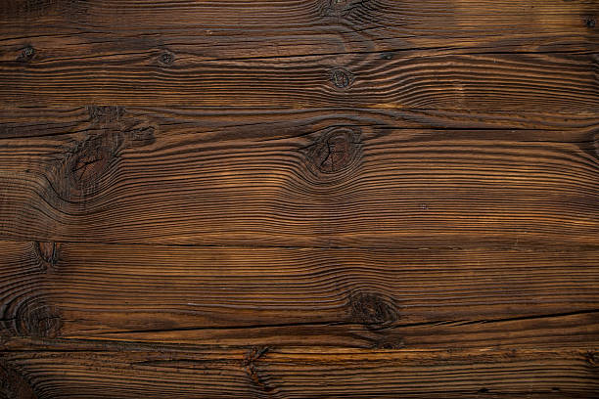

SE
Dept.
A Pirate Packing solver
Students: Ariel Berkovich, Matan Keren| Supervisor: Dr.Miri Weiss Cohen | Date: 4/7/19

Slide 2



Introduction
2
Finding the most beneficial way to pack items can be extremely
valuable to the world of industry
Our project provides a different approach to solving a certain type
of packing called:
The Pirate Packing

Slide 3
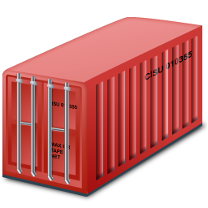

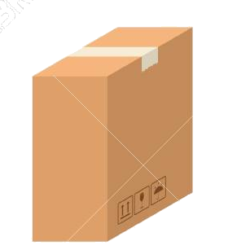
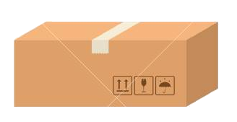
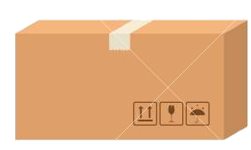
The Pirate Packing problem
3
Its an optimization where given:
A bin type container
A set of boxes with values
And the goal is to:
Find the most beneficial bin-packing

Slide 4
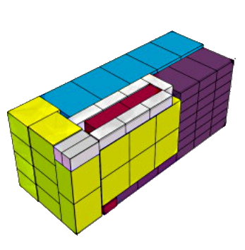
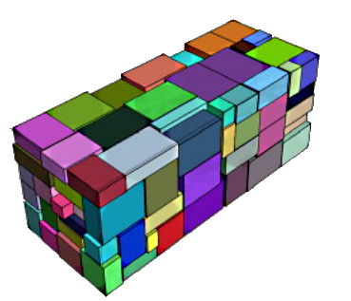


Example
4

Slide 5
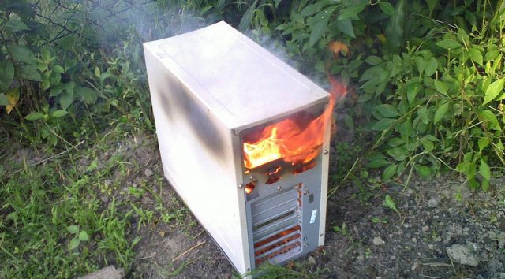
Conventional solution of Pirate Packing problem
5
The problem itself is NP-hard
Greedy approaches rarely suffice
Given the 3D nature of the problem, dynamic programming is too demanding

Slide 6

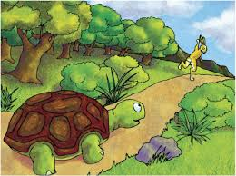


Our approach
Our approach consists of solving the 3D Knapsack-Bin problem using Genetics Algorithm instead of an exact solution. Using this approach, the solution will be:
Much faster
Space efficient
Beneficial - good results

Slide 7
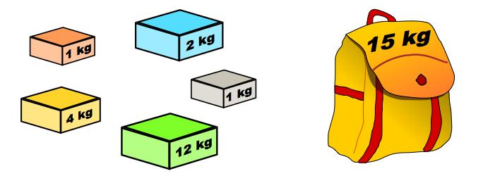
Background – Knapsack problem
Given:
A set of n items: <item1,item2,...,itemN> → each item is specifiedby a its weights Wi and Value Vi
A capacity bound S, the capacity of the knapsack
The goal is to find which subset of the items to take into the knapsack which maximize the overall value of the knapsack

Slide 8
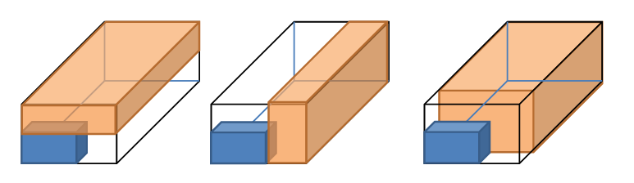
Background - Bin packing
8
The bin packing problem is an optimization problem where
There are N boxes and M bins
The goal is to pack as many boxes as possible in M bins, or
to pack all N items in the minimum number of bins

Slide 9
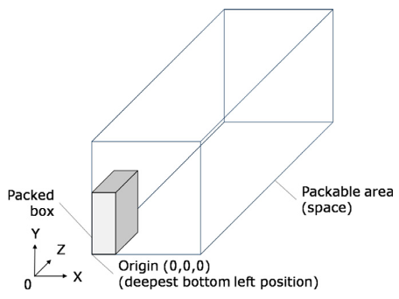
Background – Deepest Bottom Left Fill
9
Placement method used in 3D bin packing
Items are inserted first to the position with the smallest Z value and smallest Y value and smallest X value

Slide 10
Genetic Algorithm - The Evolution cycle
Parent selection
Initialization
Gen i
Roulette wheel
init gen 0
Survivor Selection
Recombination
generated children
Mutation
pre-mutations children

Slide 11
Binary approach
Represent each solution as a binary string
store for each item :
it’s orientation
it’s position - X,Y,Z coordinates inside the knapsack
1 | 1 | 0 | 0 | 0 | 1 | 0 | 1 | 0 | 0 | 0 | 0 | 1 | 0 | 1 | 0
is Item in knapsack 1 means yes
Item orientation
X
Y
Z
Item 0
Item 1
1 | 1 | 0 | 1 | 0 | 1 | 0 | 1 | 0 | 0 | 0 | 0 | 1 | 0 | 1 | 0 | 0 | 1 | 0 | 0 | 0 | 1 | 0 | 1 | 1 | 0 | 0 | 1 | 1 | 1 | 1 | 0
... |  |  |  |  |  |  |  |  |  |  |  |  |  |  |  | 1 | 0 | 1 | 1 | 1 | 0 | 0 | 0 | 0 | 1 | 1 | 1 | 0 | 0 | 1 | 0
Item n

Slide 12

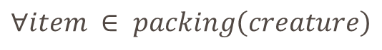
Fitness function of the binary
$$Fitness\left(creature\right)=$$
$$\sum{\begin{aligned} value\left(item\right)+cornerBonus\left(item\right)+ \frac{connectBonus\left(item\right)}{4} \\ \end{aligned}}$$
$∀item ∈ packing\left(creature\right)$
To get the most value efficient packing
To encourage expanding to the corners of the container
To encourage connection between items and thus improving compression rate

Slide 13
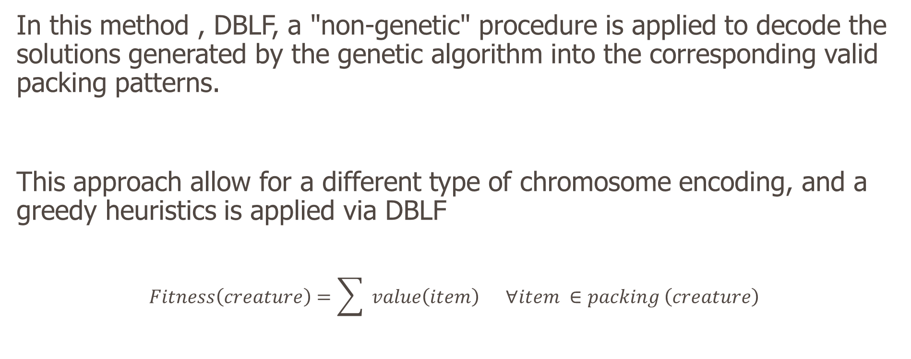
Hybrid Genetic Algorithm with Heuristics
In this method , DBLF, a "non-genetic" procedure is applied to decode the solutions generated by the genetic algorithm into the corresponding valid packing patterns.
This approach allow for a different type of chromosome encoding, and a greedy heuristics is applied via DBLF
$$Fitness\left(creature\right)=\sum{ value\left(item\right) ∀item ∈packing}\left(creature\right)$$

Slide 14
Order Encoding
x1 | x2 | x3 | x4 | x5 | ... | xn
xi = index of the i item to pack
items are placed according to this order of indexes
packing is done using DBLF(Deepest bottom left fill) packing
the algorithm packs every item that in can according to the attempting order guided by the chromosome

Slide 15
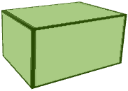

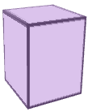
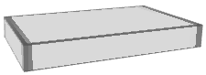
Example
Item 1
Item 2
Suppose we have those items:
so these encoding will result in the packing order:
Item 4
Item 3
3 | 1 | 4 | 2
Item3
Item1
Item4
item2

Slide 16
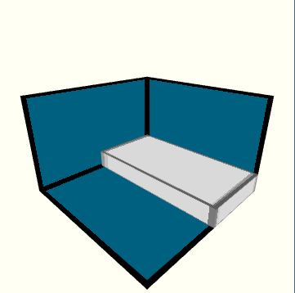
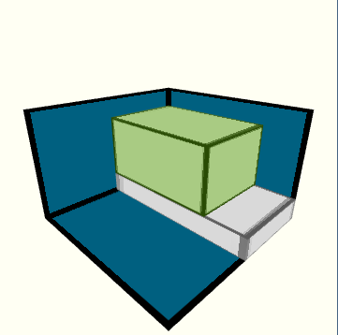
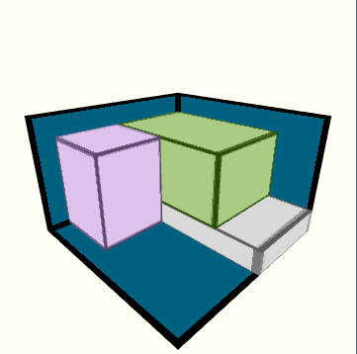
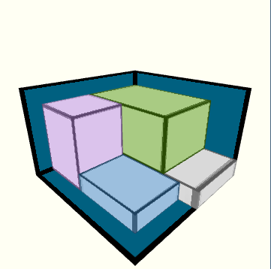


Visualization of
3 | 1 | 4 | 2

Slide 17
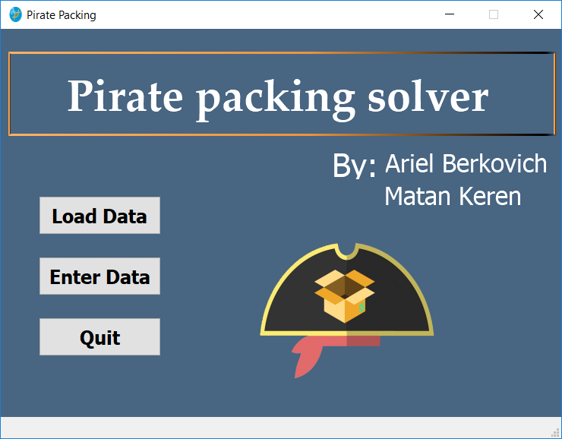
GUI - Main Window

Slide 18
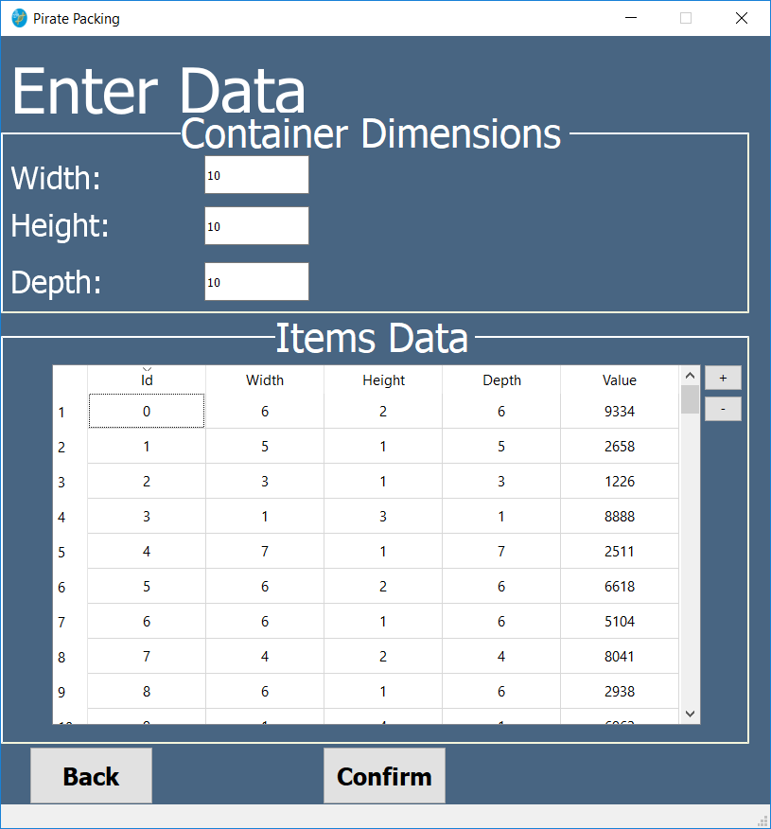
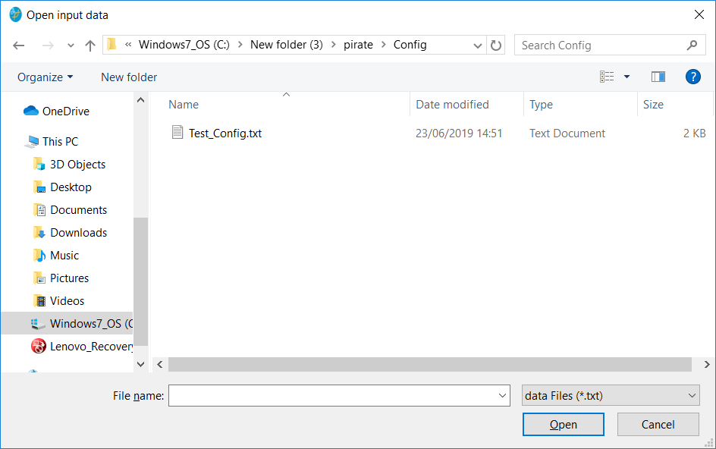
GUI - Entering problem data

Slide 19
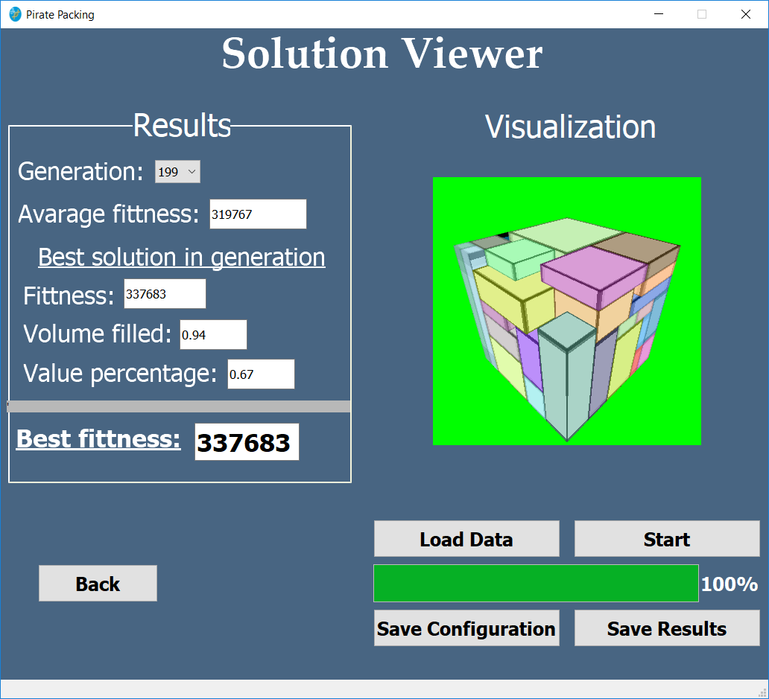
GUI - Solution Viewer

Slide 20
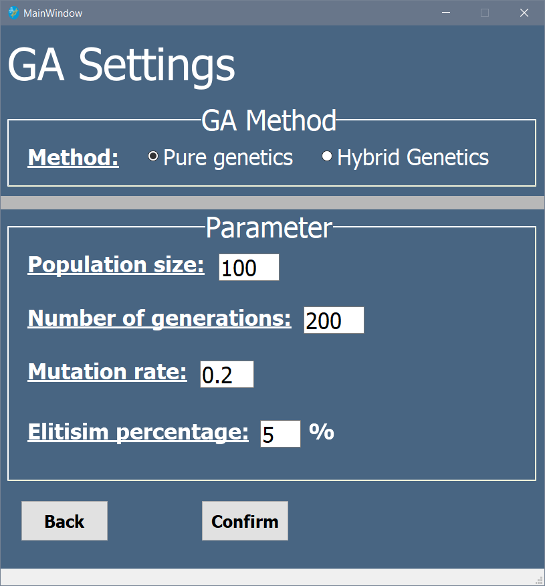
GUI - Adjust GA Parameters

Slide 21
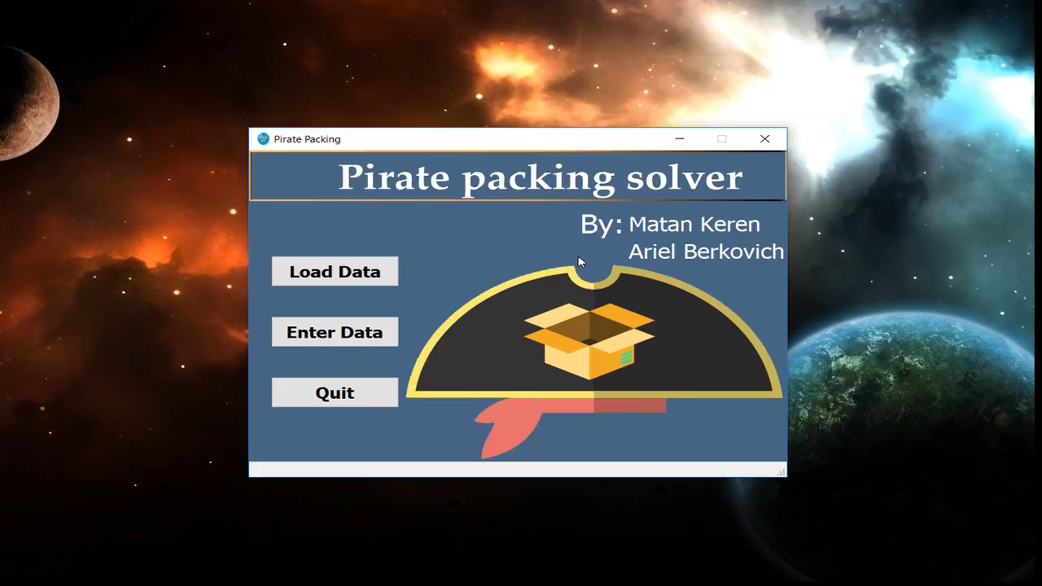
Demonstration

Slide 22


Slide 23
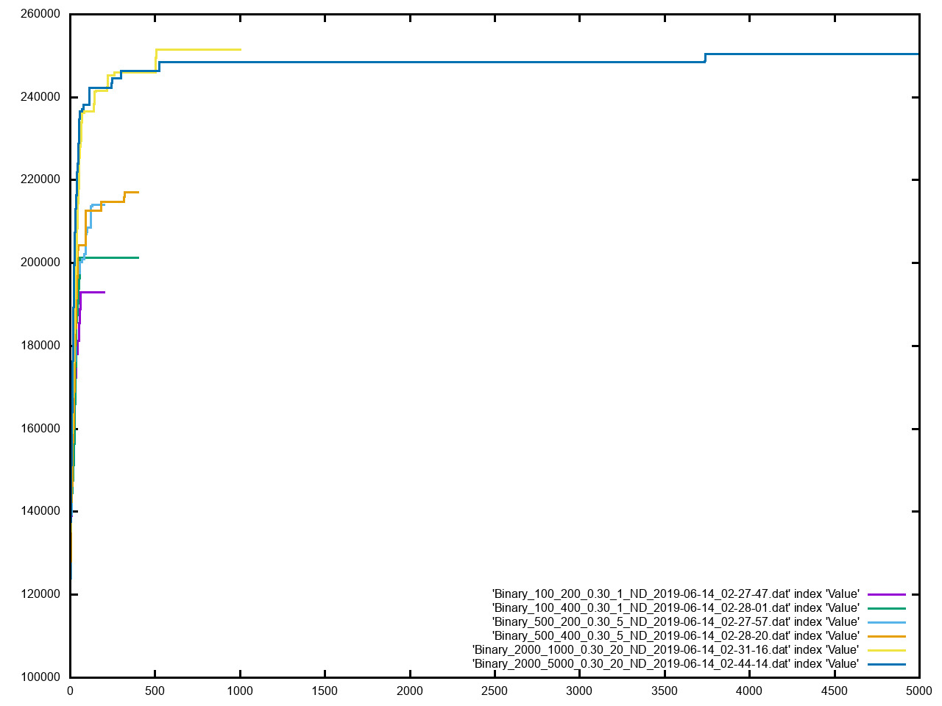

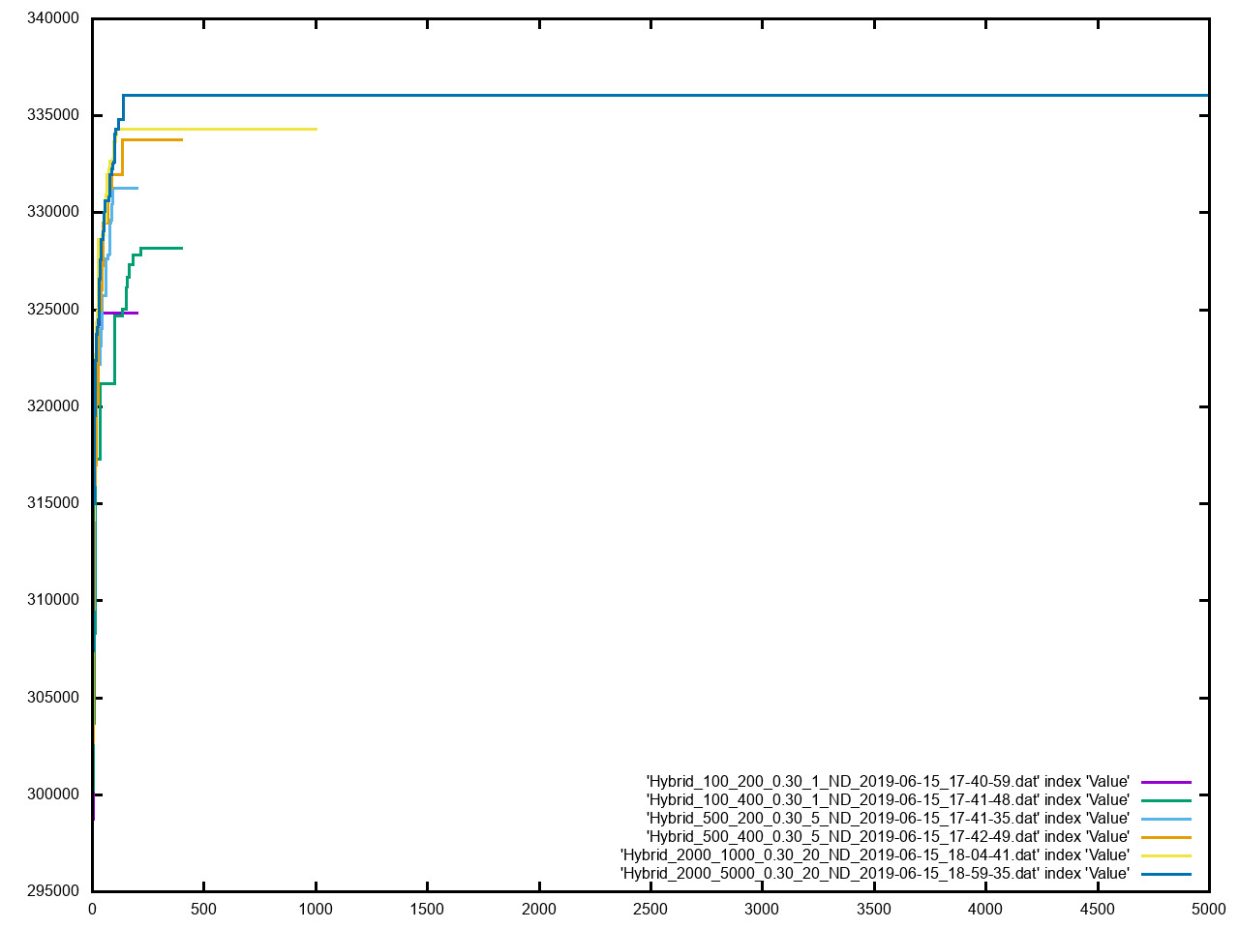
Population = 2000, Generations = 1000 → Best results
Binary
hybrid

Slide 24
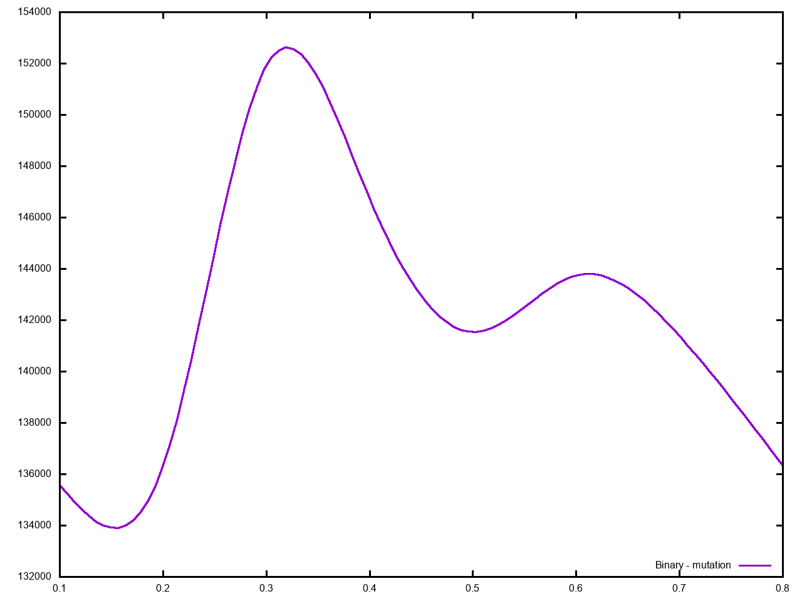
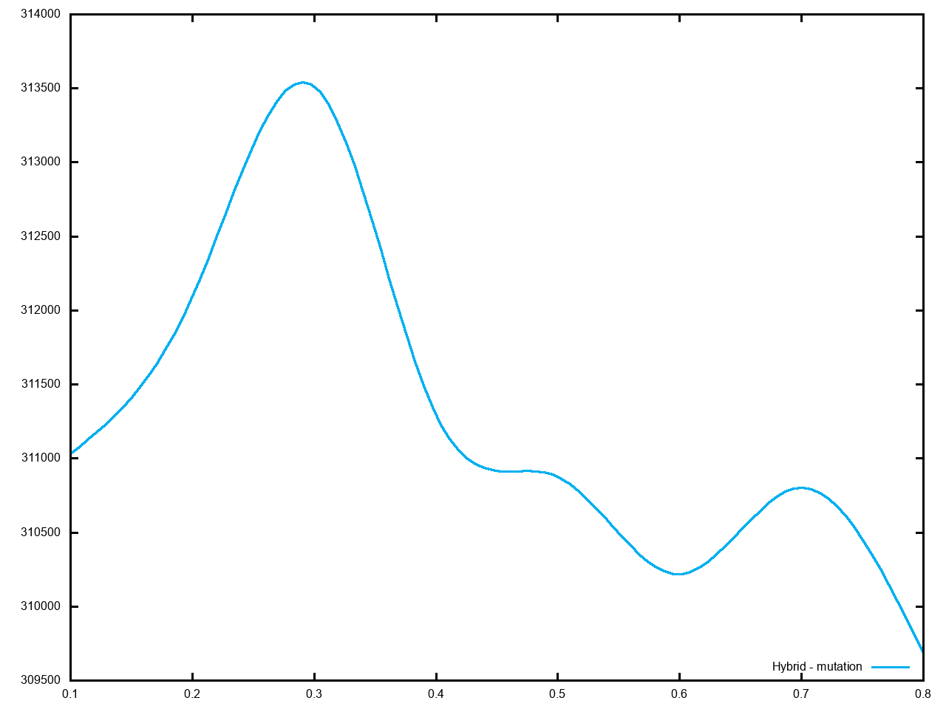
Best Mutation – 0.3
Binary
Hybrid

Slide 25
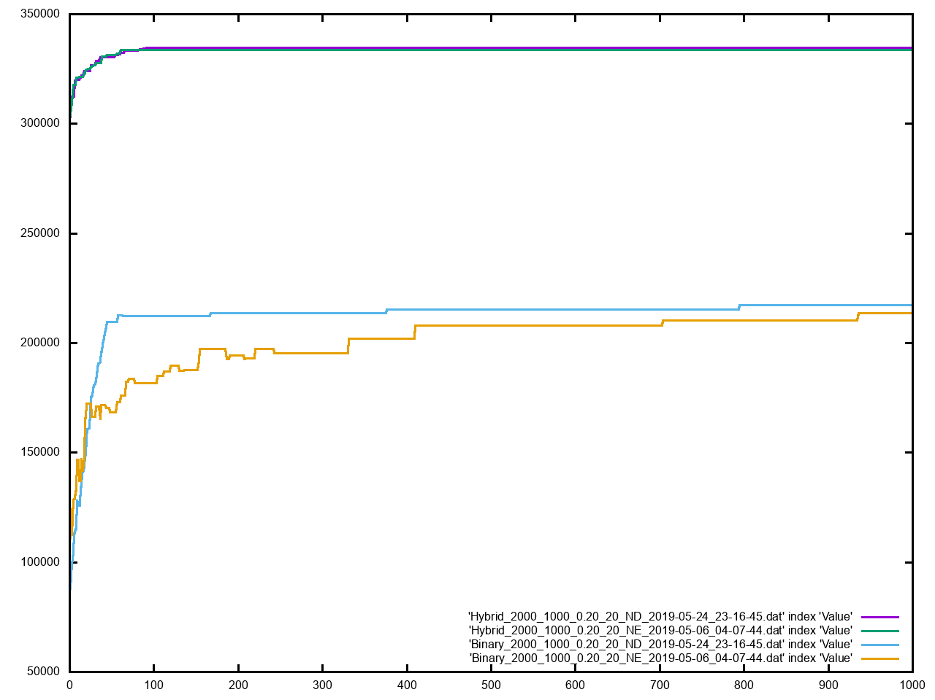
Niching attempt - Shared Fitness - Value

Slide 26
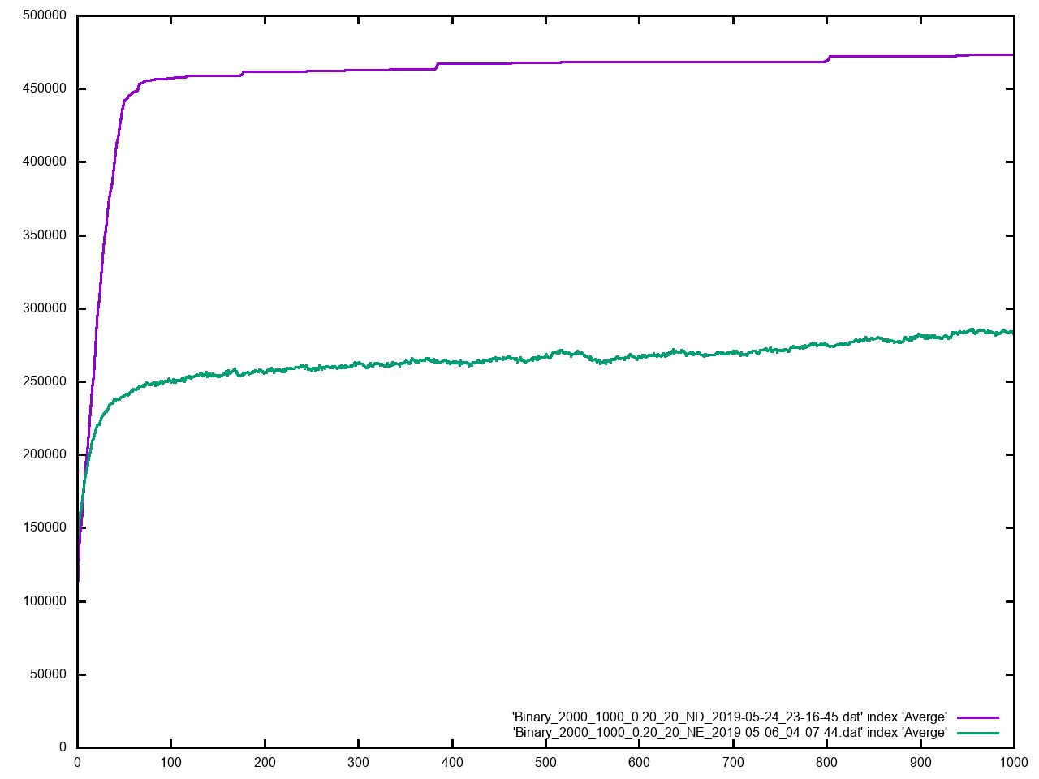
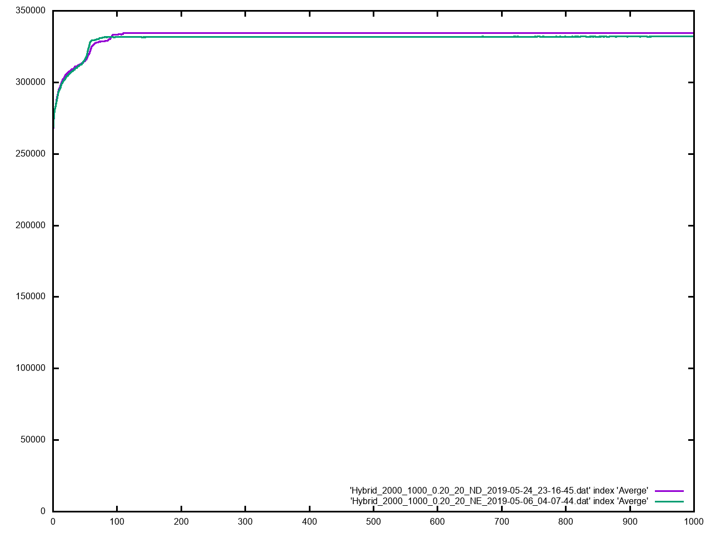
Niching attempt - Shared Fitness – Average fitness
Binary
hybrid

Slide 27
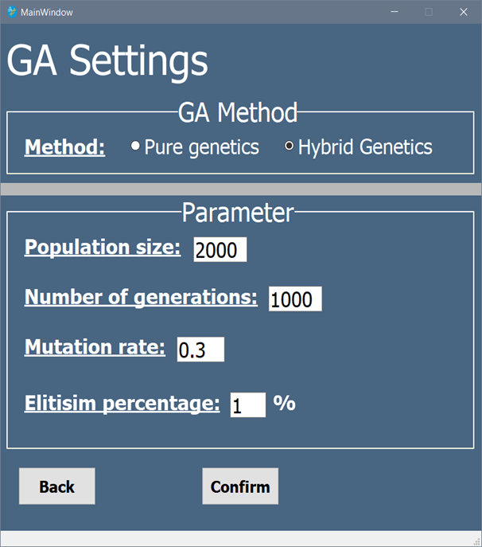
Full parameters
After several tests, we have concluded that these are the best parameters to use:
Method = hybrid
Population size = 1000
Number of generations = 2000
Mutation rate = 0.3
Elitism percentage = 1%

Slide 28
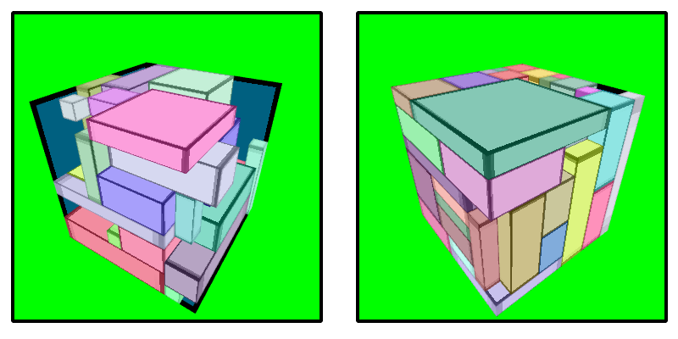
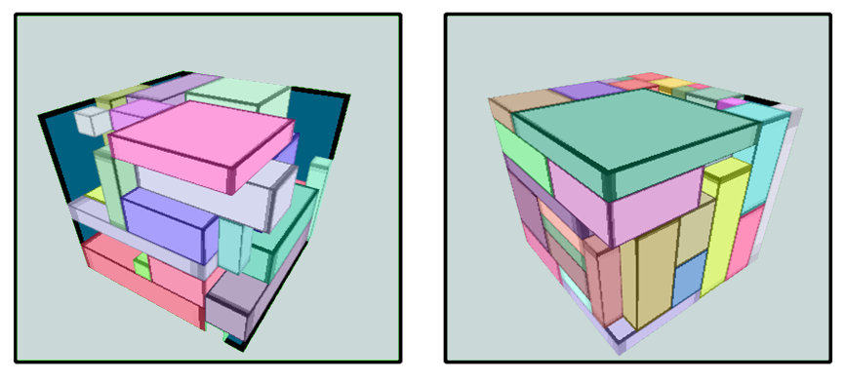
Binary Versus hybrid comparison
A visual comparison between the binary and hybrid approach trying to solve the same problem with the same parameters and dataset
Binary
Hybrid

Slide 29
Binary Versus hybrid comparison
 | Binary | Hybrid
Volume filled percentage | 57% | 96%
Number of items packed | 36 | 53
­Overall value of the items taken | 239237 | 299947
Performance time | 11 minutes and 20 seconds | 14 minutes and 40 seconds

Slide 30
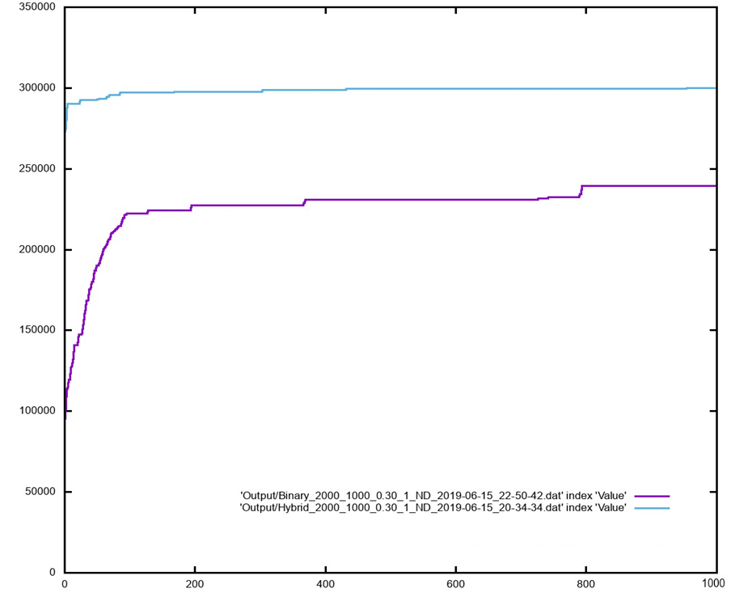



Progress of both methods

Slide 31
Conclusions
The hybrid approach is better suited to solving the pirate packing problem
Applying the DBLF heuristics allowed more compressed solutions which is what led to the superiority of the hybrid approach, binary’s approach produced less full and non compressed solutions
The binary approach was much faster than the hybrid as it lacks heuristics
The binary approach didn’t take into account the volume of the manifested packing and thus in order to solve it with the binary a multi-objective optimizer is required

Slide 32
References
Wu, Yong, et al. "Three-dimensional bin packing problem with variable bin height." European journal of operational research, 2010.
Johnson, David S. Near-optimal bin packing algorithms. Diss. Massachusetts Institute of Technology, 1973.
Graham RL (1966) Bounds for certain multiprocessing anomalies. Bell Syst Tech J 45:1563–1581.
Mathews, G. (1897). On the partition of numbers. Proceedings of the London Mathematical Society, 28, 486-490.
Chor, Benny, and Ronald L. Rivest. "A knapsack-type public key cryptosystem based on arithmetic in finite fields." IEEE Transactions on Information Theory 34.5 1988.
Rahim, Sahar, et al. "Towards multiple knapsack problem approach for home energy management in smart grid." Network-Based Information Systems (NBiS), 2015 18th International Conference on. IEEE, 2015.‏
Gambrah, Patience Pokuaa. Plastic bags waste management using the knapsack model case study: trashy bags, Accra. Diss. 2011
‏J.H. Holland. "Adaption in Natrual and Artificial Systems" MIT Press,Cambridge, MA 1992. 1st edition: The University of Michigan Press, Ann Arbor, 1975.
R. Malhotra, N. Singh and Y. Singh. Genetic Algorithms: Concepts, design for optimization of process controllers. Computer and Information Science, 4:2, 2011
Darwin, Charles. On the origin of species, 1859.
EIBEN, Agoston E., et al. Introduction to evolutionary computing. Berlin: springer, 2003
DOWNEY, Austin; HU, Chao; LAFLAMME, Simon. Optimal sensor placement within a hybrid dense sensor network using an adaptive genetic algorithm with learning gene pool. Structural Health Monitoring, 2018, 17.3: 450-460
KARABULUT, Korhan; İNCEOĞLU, Mustafa Murat. A hybrid genetic algorithm for packing in 3d with deepest bottom left with fill method. In:
International Conference on Advances in Information Systems. Springer, Berlin, Heidelberg, 2004. p. 441-450.

Slide 33
References
Ala'a appl, and Azzam Sleit. "Resource Utilization in Cloud Computing as an Optimization Problem." Resource 7.6 (2016).
Hopper, E., and B. Turton. "A genetic algorithm for a 2D industrial packing problem." Computers & Industrial Engineering37.1-2 (1999).
Dyckhoff, Harald. "A typology of cutting and packing problems." European Journal of Operational Research ,1990.
Wäscher, Gerhard, Heike Haußner, and Holger Schumann. "An improved typology of cutting and packing problems." European journal
of operational research, 2007‏
Fekete, Sándor P., Jörg Schepers, and Jan C. Van der Veen. "An exact algorithm for higher-dimensional orthogonal packing." Operations Research 2007
Mostaghimi Ghomi, Hanan, Bryan Gary St Amour, and Walid Abdul-Kader. "Three-dimensional container loading: A simulated annealing approach.“
International Journal of Applied Engineering Research 12.7 ,2017.
Egeblad, Jens, and David Pisinger. "Heuristic approaches for the two-and three-dimensional knapsack packing problem.
" Computers & Operations Research, 2009
Ghomi, H. Mostaghimi. Three-dimensional knapsack problem with pre-placed boxes and vertical stability. Diss. Ph. D. dissertation, University of Windsor, 2013
Goncalves, J.F., 2007, ‘A hybrid genetic algorithm-heuristic for a two-dimensional orthogonal packing problem’, European Journal of Operation Research, 2007.
Bortfeldt, Andreas, and Tobias Winter. "A genetic algorithm for the two-dimensional knapsack problem with rectangular pieces."
International Transactions in Operational Research, 2009

Slide 34
Thank you !

